Slide 1
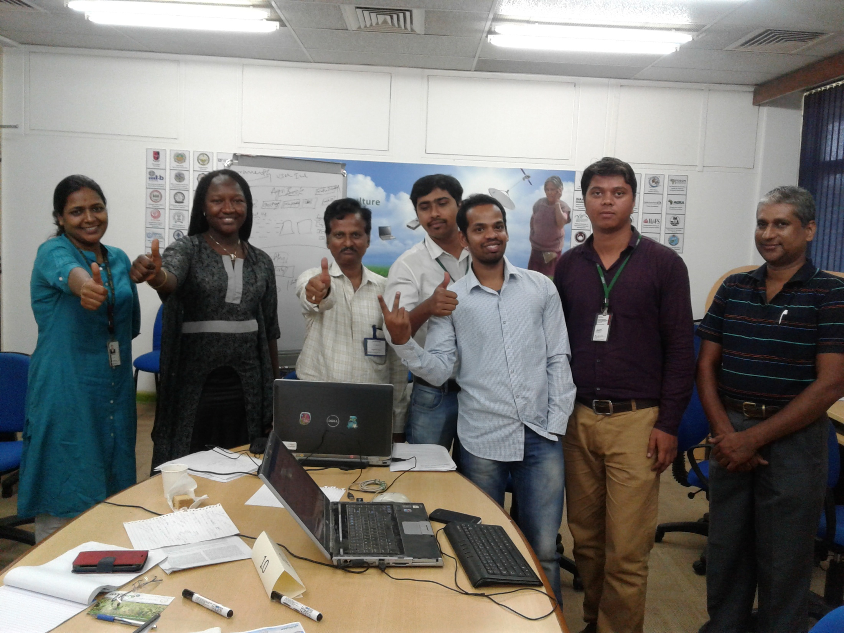
Team 10: Farmers’ Friend
Notes:
We are team 10

Slide 2
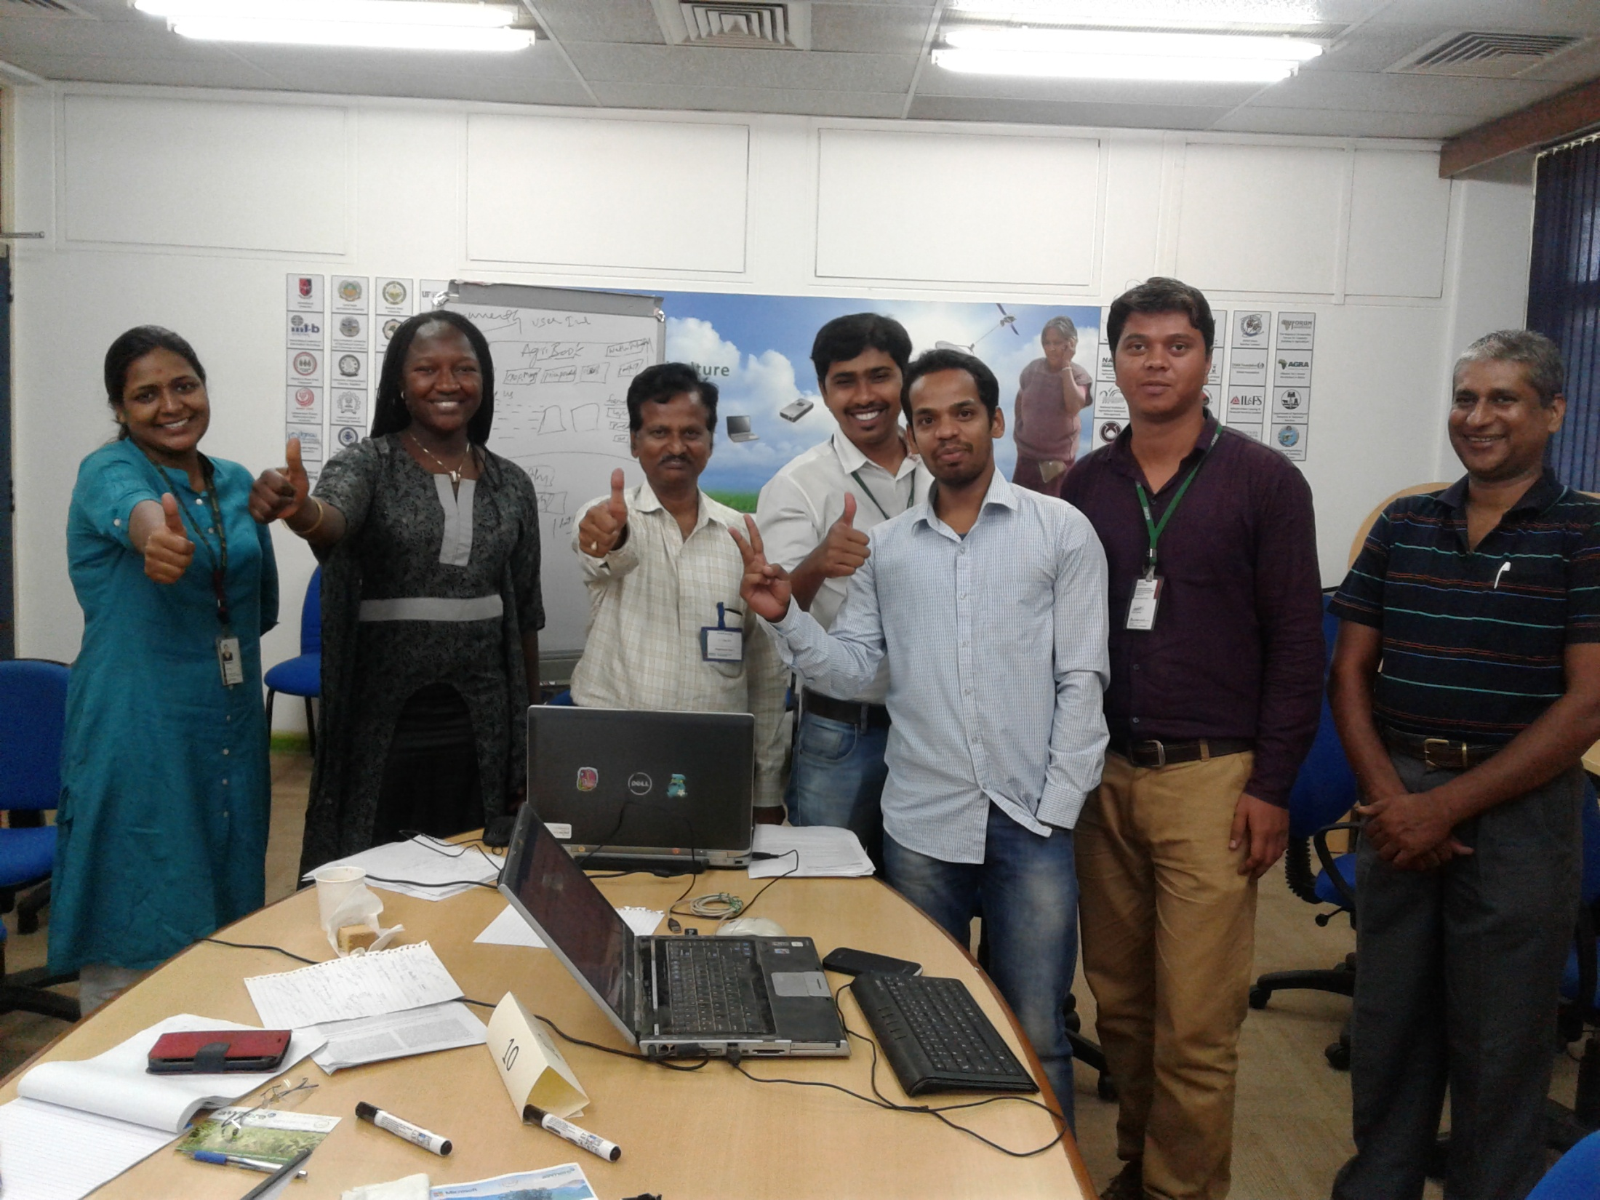
Team members
V. Nageswara Rao, Systems modeler
D. Madina Diancoumba, Crop modeler
S. Dharani, Modeling and GIS Specialist
G. Yogesh, Research Scholar (Soil Science)
M.Praneeth Kumar, Research Scholar (ICT in Agriculture)
G. Sandeep, Software Engineer
RVV. Prasad Rao, Software Engineer

Slide 3
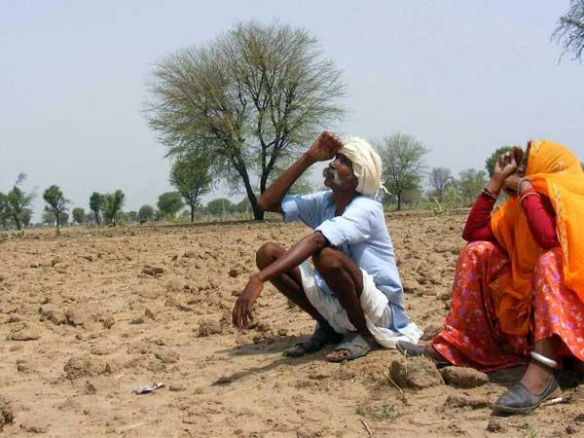
Farmers’ dilemma
What the ensuing season is likely to be?
When and what crop to sow?
What is the appropriate cropping system for the season?
What will be market price of my commodity
Is this system profitable?

Slide 4
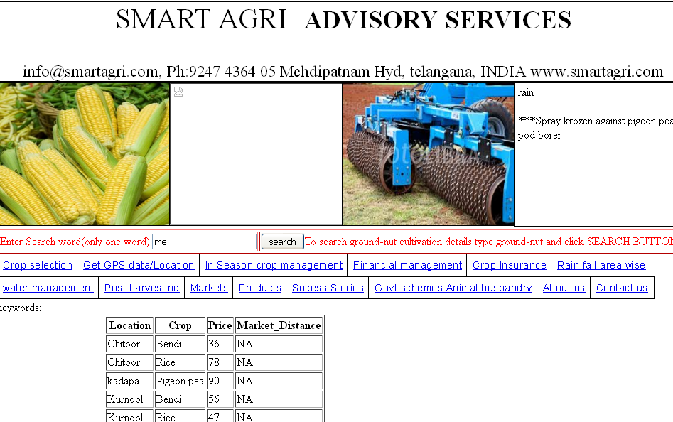

Slide 5

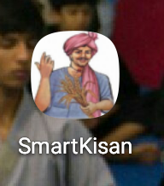
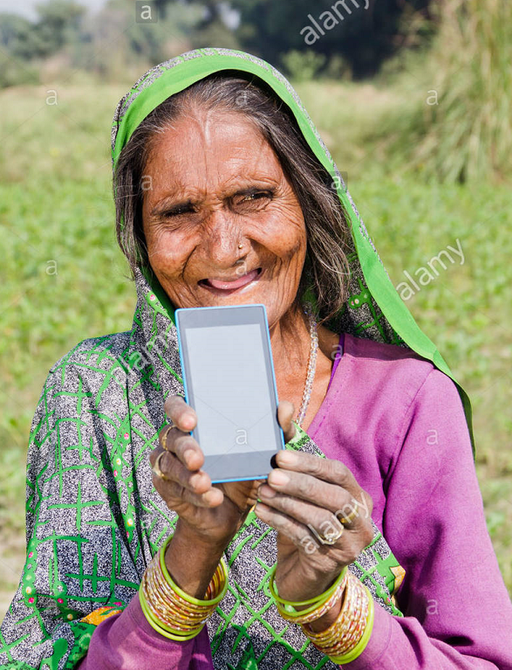
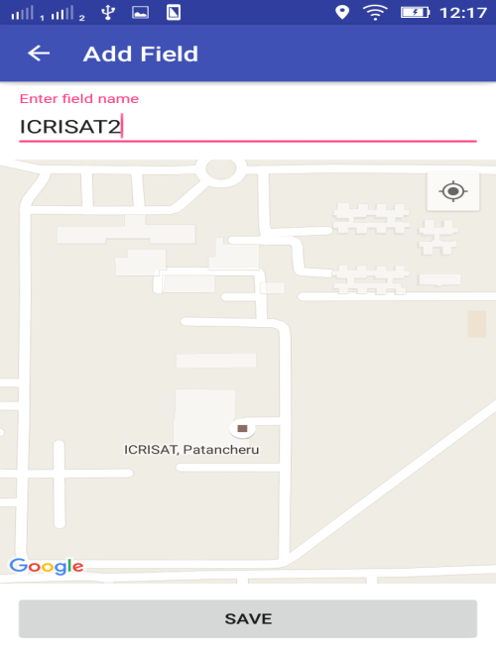
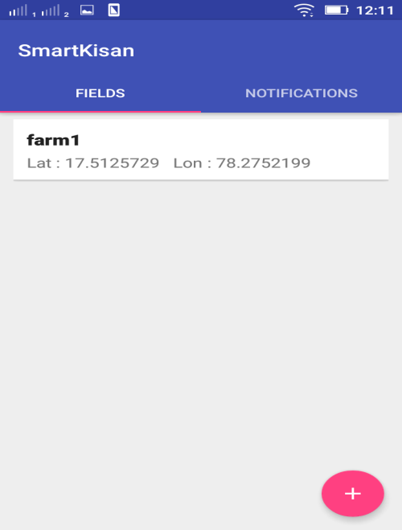
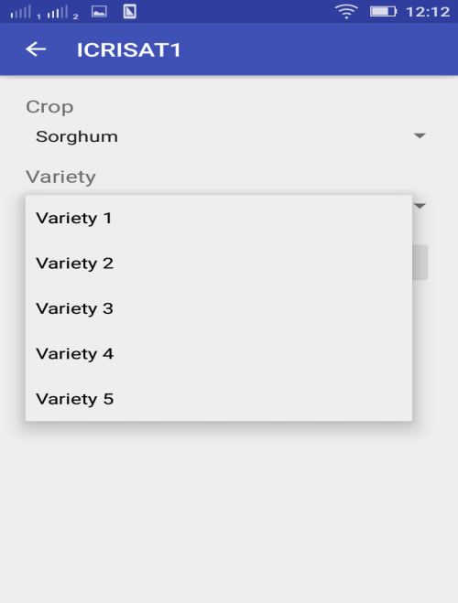
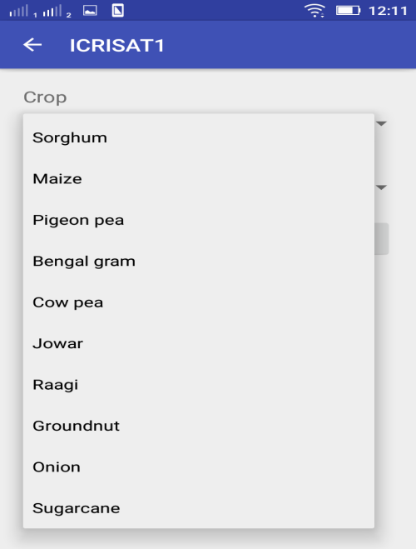
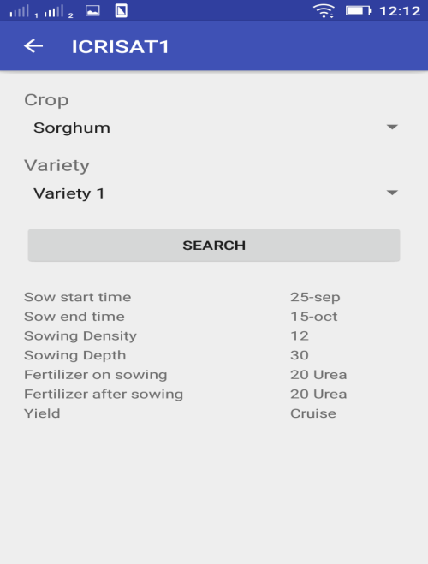

Slide 6
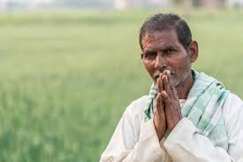
Thank you farmers’ friend!

